Slide 1
Machine Learning Algorithm

Slide 2
Machine learning
Computer programs that uses algorithms to analyze data make intelligent predictions based
on the data without being explicitly programmed.
Algorithms:
An algorithm is a set of commands that must be followed for a computer to perform calculations or other problem-solving operations.

Slide 3
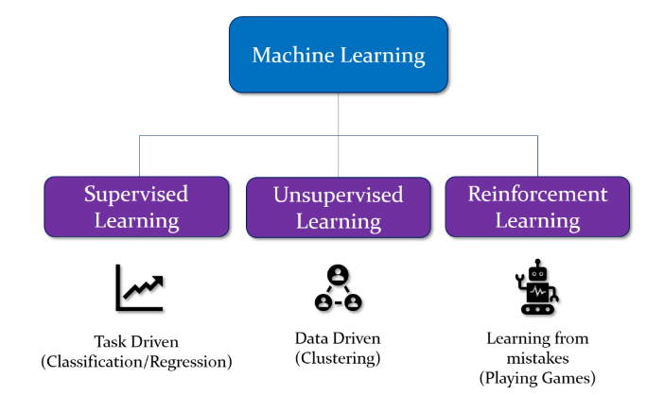
Types

Slide 4
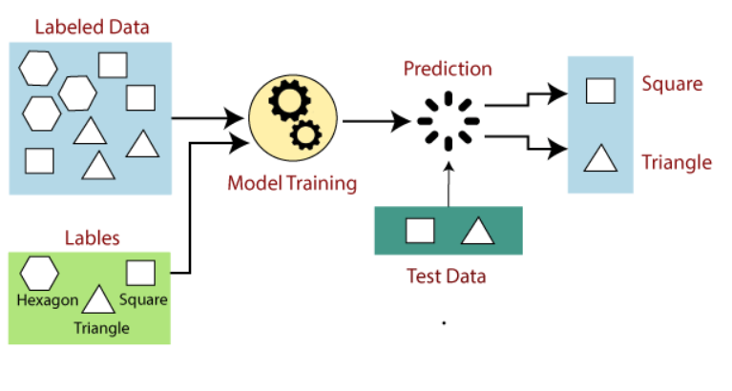
Supervised Learning
We used to labeled dataset to train the model

Slide 5
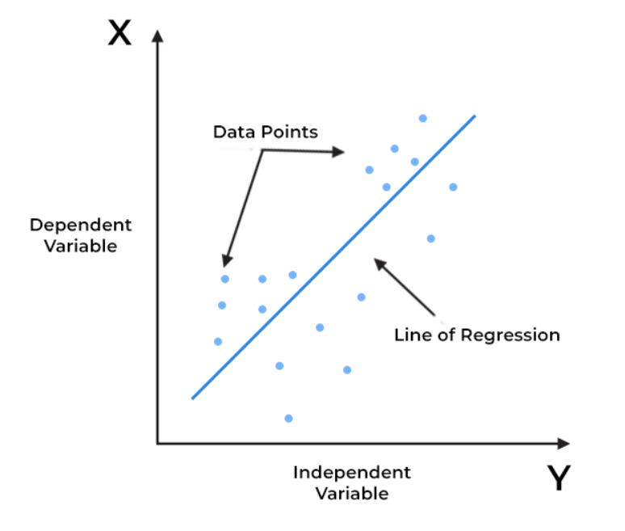
Linear Regression
It is a type of supervised machine learning algorithm
that computes the linear relationship between the
dependent variable and one or more independent
features by fitting a linear equation to observed data.
It is used as least square method.
Example: Relationship between house size and price

Slide 6
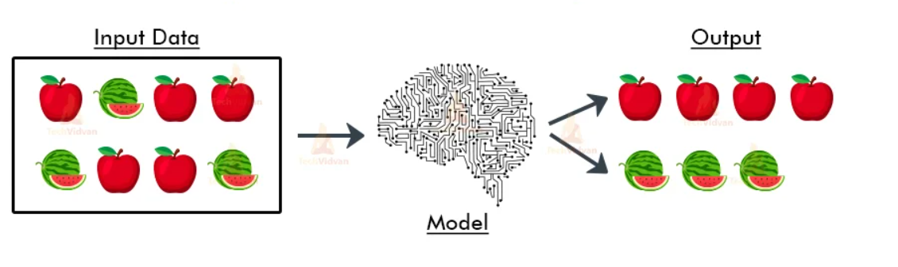
Unsupervised Learning

Slide 7
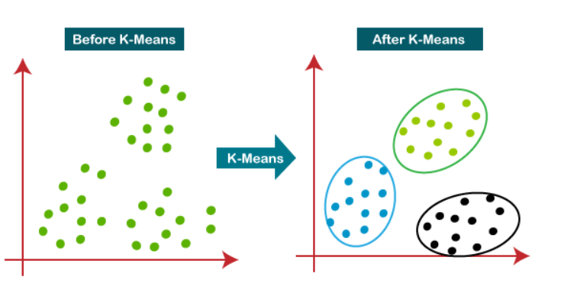
K-Means Clustering
It is an iterative algorithm that divides the unlabeled dataset into k different clusters in such a way
that each dataset belongs only one group that has similar properties.

Slide 8
PCA
Principal Component Analysis (PCA) is an unsupervised learning algorithm technique used to examine the interrelations among a set of variables. It is also known as a general factor analysis where regression determines a line of best fit.
The main goal of Principal Component Analysis (PCA) is to reduce the dimensionality of a dataset while preserving the most important patterns or relationships between the variables without any prior knowledge of the target variables.

Slide 9
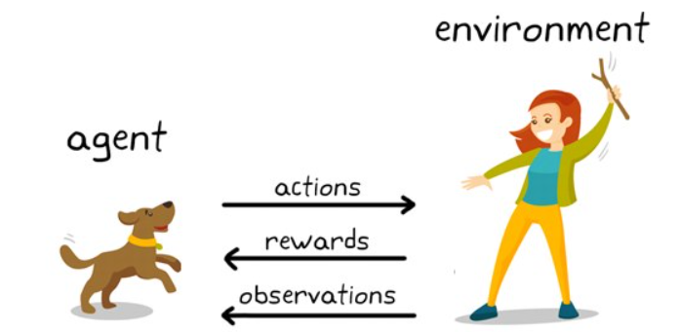
Reinforcement Learning

Slide 10
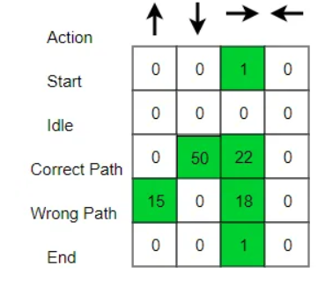
Q-Learning
Q-learning is a popular model-free reinforcement learning algorithm used in applications. It falls under the category of temporal difference learning techniques, in which an agent picks up new information by observing results, interacting with the environment, and getting feedback in the form of rewards.
Example: Maze Problem

Slide 11
Conclusion
Linear regression provides a simple yet powerful method to predict continuous outcomes
based on linear relationships.
Useful in various domains beyond real estate, such as finance, healthcare, and more.
The main goal of Principal Component Analysis (PCA) is to reduce the dimensionality
of a dataset while preserving the most important patterns or relationships between the
variables without any prior knowledge of the target variables.
Q-Learning helps the robot learn the best path through the maze by try among different
actions and learning from reward and penalties.

